Slide 1
DenseCut: Densely Connected CRFs for Realtime GrabCut
Ming-Ming Cheng^{1, 2} Victor Adrian Prisacariu² Shuai Zheng²
Philip H. S. Torr² Carsten Rother³
¹Nankai University ²Oxford University ³TU Dresden

Slide 2
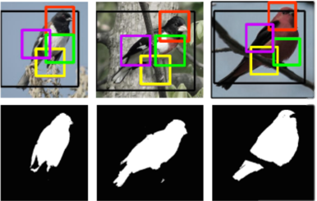
BB Image Segmentation - Applications
Image Editing
Rother et al. [SIGGRAPH 04]
Semantic Segmentation
Russell et al. [ICCV 09]
Fine-Grained Categorization
Chai et al. [ICCV 13]
Object detectioin
Carreira & Sminchisescu [PAMI 12]
Notes:
“GrabCut” — Interactive Foreground Extraction using Iterated Graph Cuts, SIGGRAH 2004
Symbiotic Segmentation and Part Localization for Fine-Grained Categorization, ICCV 2013

Slide 3
Image Segmentation
$$E\left(x\right)=\sum_{i∈N}{\left(P_{F}\left(I_{i},Θ_{F}\right)\left[x_{i}=1\right]+P_{B}\left(I_{i},Θ_{B}\right)\left[x_{i}=0\right]\right)}+\sum_{ij∈N_{8}}{w_{ij}[x_{i}≠x_{j}]}$$
Foreground color fitting term
Background color fitting term
$$P_{F}\left(I_{i},Θ_{F}\right)=−\log{P\left(I_{i}|Θ_{F}\right)}$$
$$P_{B}\left(I_{i},Θ_{B}\right)=−\log{P\left(I_{i}|Θ_{B}\right)}$$

Slide 4
Image Segmentation
$$E\left(x\right)=\sum_{i∈N}{\left(P_{F}\left(I_{i},Θ_{F}\right)\left[x_{i}=1\right]+P_{B}\left(I_{i},Θ_{B}\right)\left[x_{i}=0\right]\right)}+\sum_{ij∈N_{8}}{w_{ij}[x_{i}≠x_{j}]}$$
$$w_{ij}=\frac{1}{\left|p_{i}−p_{j}\right|}\exp\left\{−β{\left|I_{i}−I_{j}\right|}^{2}\right\}$$
Long distance have less influence
Edges are more likely to be cut

Slide 5
Image Segmentation
$$E\left(x\right)=\sum_{i∈N}{\left(P_{F}\left(I_{i},Θ_{F}\right)\left[x_{i}=1\right]+P_{B}\left(I_{i},Θ_{B}\right)\left[x_{i}=0\right]\right)}+\sum_{ij∈N_{8}}{w_{ij}[x_{i}≠x_{j}]}$$
$$x^{∗}=\arg{\min_{x}{E\left(x\right)}}$$
Can be solved in polynomial time, with global optimal

Slide 6
GrabCut
$$E\left(x\right)=\sum_{i∈N}{\left(P_{F}\left(I_{i},Θ_{F}\right)\left[x_{i}=1\right]+P_{B}\left(I_{i},Θ_{B}\right)\left[x_{i}=0\right]\right)}+\sum_{ij∈N_{8}}{w_{ij}[x_{i}≠x_{j}]}$$
$$x^{∗}=\arg{\min_{x,Θ_{F},Θ_{B}}{E\left(x,Θ_{F},Θ_{B}\right)}}$$
NP-hard problem [Vicente et al. ICCV’09]
Main problem in this talk: What is the best optimization and modelling to jointly optimize for appearance and segmentation.

Slide 7
Block Coordinate Descent
$$\arg{\min_{Θ_{F},Θ_{B}}{E\left(x,Θ_{F},Θ_{B}\right)}}$$
$$\arg{\min_{x}{E\left(x,Θ_{F},Θ_{B}\right)}}$$
Estimating the color distribution
Graph cut to infer segmentation
Rother et al. [SIGGRAPH 04]

Slide 8
Optimization over $Θ$’𝑠 help

Slide 9
Optimization is NP-hard
Joint Optimization of Appearance and Segmentation [Vicente et al. ICCV’09]

Slide 10
#1: A global optimizer
GMM $→$ histogram, reformulate purely in terms of unknown segmentation, using high order MRF.
A tight lower bound verify global optimal for many real-world examples.
Joint Optimization of Appearance and Segmentation [Vicente et al. ICCV’09]

Slide 11
Some results
Globally Optimal in 61% of cases ... but runtime is ~90s for a 250 x 160 image

Slide 12
#2: Adapt parts that are hard to optimize
The part of the higher order MRF that make the problem NP-Hard, volume regularization for ‘equal area’, is less relevant in practical applications.
[GrabCut in One Cut, Tang, Gorelick, Veksler, Boykov, ICCV ’13]

Slide 13
GMMs vs. Histograms
GMMs can better adapt to the colors of the image
Histogram treat different color bins equally differently, ignoring actual color values
Notes:
Compared to histograms, GMMs can better adapt to the colours of the image, while still being effective at capturing small appearance differences between foreground and background. Furthermore, the histogram representation will treat different colours equally differently, ignoring the color values of the histogram bins.

Slide 14
#3: New interpretation of an existing technique
$$E\left(x\right)=\sum_{i<j}{ψ_{i}\left(x_{i}\right)}+\sum_{i<j}{w_{ij}\left[x_{i}≠x_{j}\right]}$$
$$w_{ij}=\overset{Color−dependent smoothing}{\overbrace{\exp\left\{−\frac{{\left|p_{i}−p_{j}\right|}^{2}}{λ_{1}}−\frac{{\left|I_{i}−I_{j}\right|}^{2}}{λ_{2}}\right\}}}+\overset{local smoothing}{\overbrace{\exp\left\{−\frac{{\left|p_{i}−p_{j}\right|}^{2}}{λ_{3}}\right\}}}$$
Efficient Inference in fully Connected CRFs, Krähenbühl et al NIPS 2011]

Slide 15
Insight: Dense CRF & Global Color Model
Insight: a fully connected CRF and a low-connected CRF with associated global colour models are very closely related.
$$E\left(x\right)=⋯+\sum_{ij∈N}{\overset{Color weighting}{\overbrace{\exp\left\{−\frac{{\left|I_{i}−I_{j}\right|}^{2}}{λ_{4}}\right\}}}\left[x_{i}≠x_{j}\right]}$$
$$E\left(x,Θ_{F},Θ_{B}\right)=…+\sum_{i∈N}{\left(P_{F}\left(I_{i},Θ_{F}\right)\left[x_{i}=1\right]+P_{B}\left(I_{i},Θ_{B}\right)\left[x_{i}=0\right]\right)}$$

Slide 16
Relationship
Theorem: The minimizer of the GrabCut functional
$x^{∗}=\arg{\min_{x}{\min_{Θ_{F},Θ_{B}}{E\left(x,Θ_{F},Θ_{B}\right)}}}$
and a fully connected CRF
$x^{∗}=arg\min_{x}E(x)$
are (nearly) the same if we replace global color model $P_{F}(I_{i},Θ_{F})$ and $P_{B}(I_{i},Θ_{B})$ by unnormalized global color model $\left|N_{F}\right|P_{F}^{′}\left(I_{i}\right)$ and $\left|N_{B}\right|P_{B}^{′}\left(I_{i}\right)$ respectively, where $\left|N_{F}\right|P_{F}^{′}\left(I_{i}\right)$ is Parzen-density estimator:
$$P_{F}^{′}\left(I_{i}\right)=\frac{1}{\left|N_{F}\right|}\sum_{j∈N_{F}}{−\frac{1}{2}\exp\left\{−\frac{{\left|I_{i}−I_{j}\right|}^{2}}{λ}\right\}}$$
Notes:
Equal area → we derived a theoretically sound method. Ignoring this ratio constraint gives us good results in practice, as in OneCut.

Slide 17
DenseCut
$$E\left(x\right)=\sum_{i<j}{ψ_{i}\left(x_{i}\right)}+\sum_{i<j}{w_{ij}\left[x_{i}≠x_{j}\right]}$$
$$w_{ij}=\overset{Color−dependent smoothing}{\overbrace{\exp\left\{−\frac{{\left|p_{i}−p_{j}\right|}^{2}}{λ_{1}}−\frac{{\left|I_{i}−I_{j}\right|}^{2}}{λ_{2}}\right\}}}+\overset{Smoothing}{\overbrace{\exp\left\{−\frac{{\left|p_{i}−p_{j}\right|}^{2}}{λ_{3}}\right\}}}+\overset{Global Color model}{\overbrace{\exp\left\{−\frac{{\left|I_{i}−I_{j}\right|}^{2}}{λ_{4}}\right\}}}$$
${\left|N_{F}\right|}/{\left|N_{B}\right|}=1$ → we actually have a proper global color model.
Ignoring this ratio constraint gives us good results in practice, as in OneCut.

Slide 18
The effect of unbalanced color model

Slide 19
Results
GrabCut GMM CUDA | GrabCut Hist. CUDA | GrabCut GMM OpenCV | OneCut | Ours | G-Truth

Slide 20
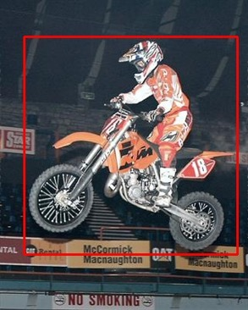
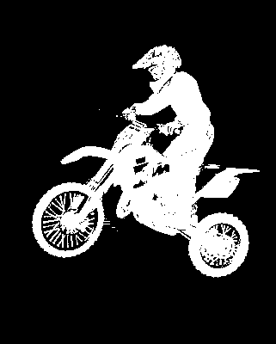
Results
GrabCut GMM CUDA | GrabCut Hist. CUDA | GrabCut GMM OpenCV | OneCut | Ours | G-Truth

Slide 21
Results
Tested on a computer with Intel Xeon E5645 2.40GHz CUP, 4GB RAM, NVIDIA Tesla K40 GPU and CUDA 7.0 SDK.

Slide 22
Failure cases
Top 50 failing examples in MSRA1K [Achanta et al. CVPR 09]
Confusing interaction & confusing appearance
Notes:
In the first example, the shadow part occurs only inside the bounding box and its appearance is quite different compared with pixels outside the bounding boxes, forcing the algorithm consider it as an object region. In the other two failure cases, some foreground regions have a large portion of similar appearance regions outside the bounding box, which confuses the algorithm and leads to missing regions for the target object.

Slide 23
Failure cases
Top 50 failing examples in MSRA1K [Achanta et al. CVPR 09]
True failure: confusing interaction & confusing appearance
Fake failure: 9/1000 GT error in top 6% failing cases & 12/50 low quality GT
Our results g-Truth Image
Incorrect ground truth annotation
Notes:
In the first example, the shadow part occurs only inside the bounding box and its appearance is quite different compared with pixels outside the bounding boxes, forcing the algorithm consider it as an object region. In the other two failure cases, some foreground regions have a large portion of similar appearance regions outside the bounding box, which confuses the algorithm and leads to missing regions for the target object.

Slide 24
Discussion
An efficient figure-ground image segmentation method
Show that fully connected CRF $⟷$ GrabCut (low-connected CRF with associated global color models)
Replace the global color model in traditional GrabCut framework with a single optimization of a fully connected CRF
Future work:
Bounding box prior
High order terms

Slide 25
Thanks!
Paper, source code, etc.: http://mmcheng.net/densecut/

Slide 26
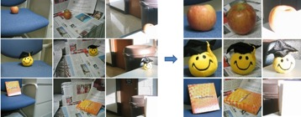
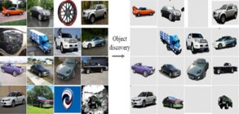
Applications
[ACM TOG 09, Chen et. al.] [Vis. Comp. 14, Cheng et. al.]
[ACM TOG 11, Chia et. al.] [ACM TOG 11, Zhang et. al.]
[CVPR 12, Zhu et. al.] [CVPR 13, Rubinstein et. al.]

Slide 27
Applications
Improve state-of-the-art by 10+% on PASCAL VOC!!
STC: A Simple to Complex Framework for Weakly-supervised Semantic Segmentation, Wei et al., arXiv 2015.

Slide 28
Efficient Inference
Message passing in the mean field framework

