Slide 1
Perceiving and Interacting with Images
Speaker: Ming-Ming Cheng
Nankai University
http://mmcheng.net/

Slide 2
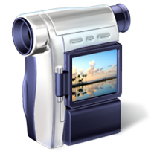
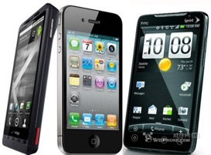
Images change the way we live
We perceive 80+% of information in terms of visual media.

Slide 3
Motivation
RGB, RGB, RGB, RGB, RGB, RGB, RGB, RGB, RGB, RGB, RGB, RGB, RGB, RGB, …
Objects, spatial relations, semantic properties, 3d, actions, human pose, …

Slide 4
Motivation: Generic object detection
Notes:
Generic object detection has made great progress in recent years. However, most state-of-the-art method still requires each category specific classifiers to evaluate many image windows in a sliding window fashion.

Slide 5
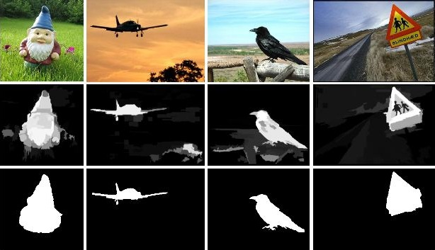
Global Contrast based Salient Region Detection, IEEE TPAMI, 2015, MM Cheng, et. al. (CVPR 2011)

Slide 6
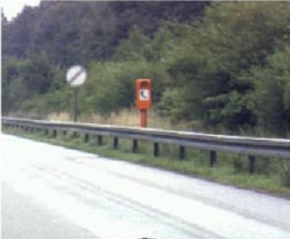
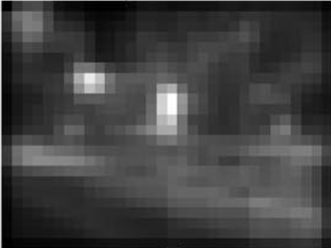
Related works: saliency detection
Fixation prediction
Predicting saliency points of human eye movement
A model of saliency-based visual attention for rapid scene analysis. PAMI 1998, Itti et al.
Saliency detection: A spectral residual approach. CVPR 2007, Hou et. al.
Graph-based visual saliency. NIPS, Harel et. al.
Quantitative analysis of human-model agreement in visual saliency modeling: A comparative study, IEEE TIP 2012, Borji et. al.
A benchmark of computational models of saliency to predict human fixations, TR 2012.
Notes:
cognitive psychology, neurobiology

Slide 7
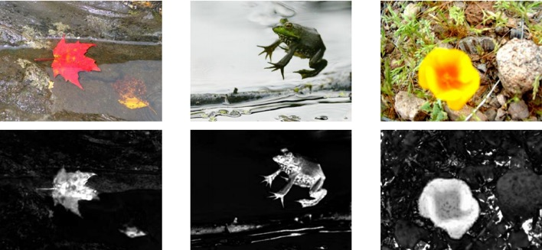
Related works: saliency detection
Salient object detection
Detect the most attention-grabbing object in the scene
Learning to detect a salient object. CVPR 2007, Liu et. al.
Frequency-tuned salient region detection, CVPR 2009, Achanta et. al.
Global contrast based salient region detection, CVPR 2011, Cheng et. al.
Salient object detection: a benchmark, Ali et. al.

Slide 8
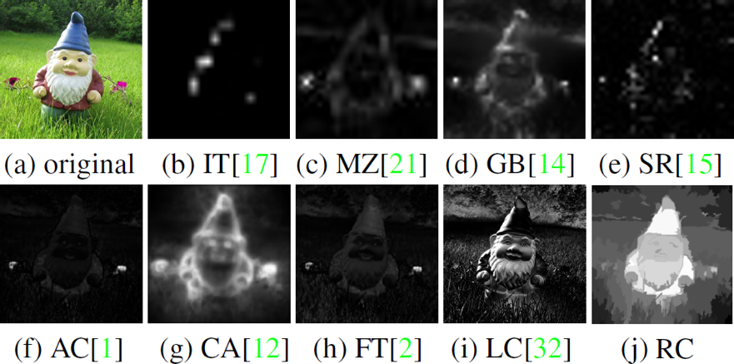
Related works: saliency detection
Observations
In order to uniformly highlight entire object regions, global contrast based method is preferred over local contrast based methods.
Contrast to near by regions contributes more than far away regions.

Slide 9
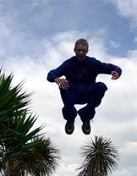
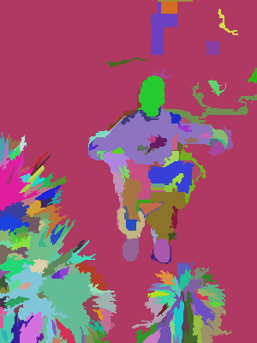
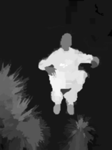
Core idea: region contrast (RC)
Image Segmentation $σ_{s}^{2}→∞$ $σ_{s}^{2}→0.4$
Spatial weighting
Region size
$S\left(r_{k}\right)=\sum_{r_{k}≠r_{i}}{\exp\left(−\frac{D_{s}\left(r_{k},r_{i}\right)}{σ_{s}^{2}}\right)}ω\left(r_{i}\right)D_{r}(r_{k},r_{i})$
Region contrast by sparse histogram comparison.

Slide 10
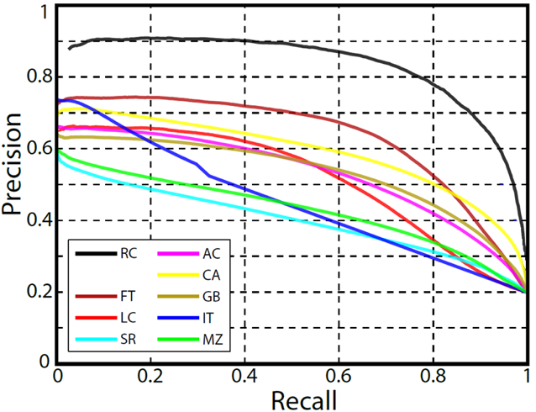
Experimental results
Dataset: MSRA1000 [Achanta09]
Precision vs. recall

Slide 11
SaliencyCut
Iterative refine: iteratively run GrabCut to refine segmentation
Adaptive fitting: adaptively fit with newly segmented salient region
Enables automatic initialization provided by salient object detection.

Slide 12
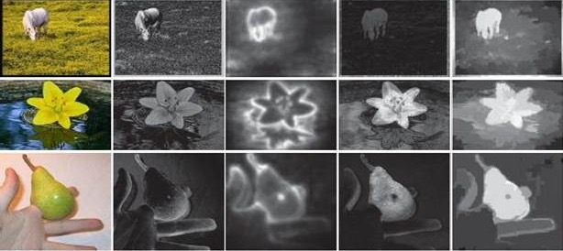
Experimental results
Dataset: MSRA1000 [Achanta09]
New state of the art (P=75%, R=83%) → (P=90+%, R=90+%)
Visual comparisons
Source code (C++) available
http://mmcheng.net/salobj/
free

Slide 13
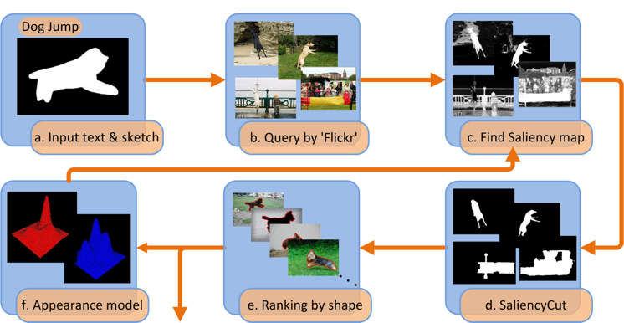
Applications
Is salient object detection for ‘simple’ images useful?
SalientShape: Group Saliency in Image Collections, The Visual Computer 2014. Cheng et. al.

Slide 14
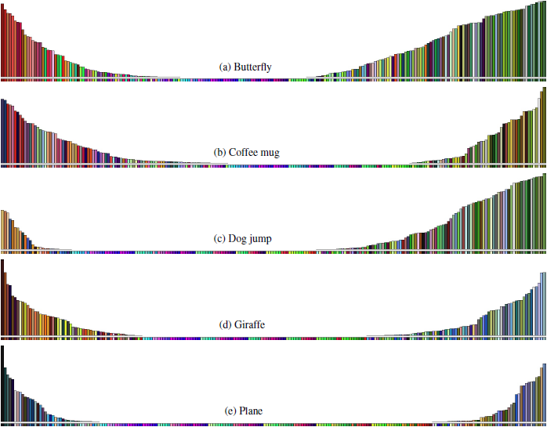
Applications
Illustration of learned appearance models
Accords with our understanding of these categories

Slide 15
Applications
T Chen, MM Cheng, P Tan, A Shamir, SM Hu, Sketch2photo: internet image montage, ACM TOG. (SIGGRAPH Asia), vol. 28, no. 5, 124:1-10, 2009.

Slide 16
Applications
J.Y. Zhu, J. W, Y. Xu, E. Chang, Z. Tu, Unsupervised Object Class Discovery via Saliency-Guided Multiple Class Learning, IEEE TPAMI 2015 (CVPR 2012).
Notes:
Adopt saliency detection to convert unsupervised learning into multiple instance learning
validates the usefulness of saliency detection to output “noisy input” for a top-down method to extract common patterns

Slide 17
Applications
Rubinstein, M., Joulin, A., Kopf, J., & Liu, C. Unsupervised joint object discovery and segmentation in internet images. IEEE CVPR 2013.
Notes:
Common object patterns should be salient within each image, while being sparse with respect to smooth transformations across images.
Used the proposed saliency measure and showed that saliency-based segmentation produces state-of-the-art results on co-segmentation benchmarks, without using co-segmentation!

Slide 18
Applications
10% improvement over state of the art!
STC: A Simple to Complex Framework for Weakly-supervised Semantic Segmentation, arXiv 2015, Wei et al.
Notes:
10.6% improvement over “P. O. Pinheiro and R. Collobert, “From image-level to pixellevel
labeling with convolutional networks,” IEEE CVPR, 2015.”

Slide 19
Applications
Don’t ask what segment can do for you, ask what you can do for the segment.

Slide 20
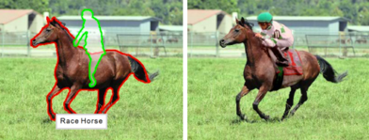
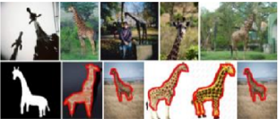
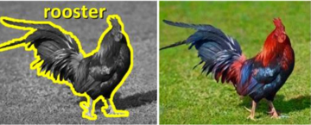
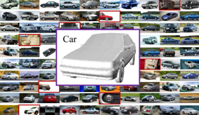
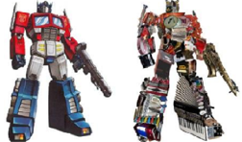
Applications
[EuroGraphics 12] [Vis. Comp. 14]
[ACM TOG 11] [Vis. Comp. 13] [ACM TOG 11]
See the 1000+ citations of our PAMI 2015 (CVPR 2011) paper for more.

Slide 21
Additional resources
Project page: http://mmcheng.net/salobj/
Benchmark
Salient Object Detection: A Benchmark, A. Borji, M.M. Cheng, H. Jiang, J. Li, IEEE TIP, 2015.
Salient Object Detection: A Survey, A. Borji, M.M. Cheng, H. Jiang, J. Li, arXiv eprint, 2014.
http://mmcheng.net/salobjbenchmark
DenseCut for Realtime GrabCut
DenseCut: Densely Connected CRFs for Realtime GrabCut, Computer Graphics Forum, 2015
free
free

Slide 22
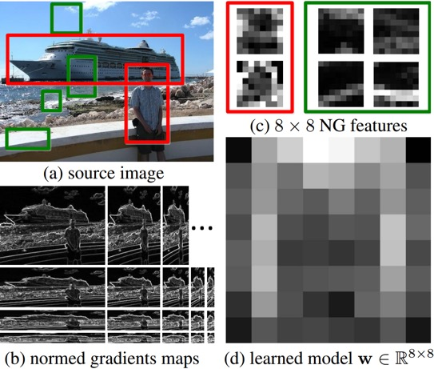
BING: Binarized Normed Gradients for Objectness Estimation at 300fp, IEEE CVPR 2014 (Oral), M.M. Cheng, et. al.

Slide 23
Motivation: What is an object?
> >
Notes:
Objectness is usually represented as a value which reflects how likely an image window covers an object of any category.

Slide 24
PASCAL VOC detection history
BING++
R-CNN (2014)
R-CNN (2014)
R-CNN (2014)
Rich feature hierarchies for accurate object detection and semantic segmentation, CVPR 2014 (Oral), Girshick et al.
BING++: A Fast High Quality Object Proposal Generator at 100fps, arXiv, Zhang et al.
Notes:
We rerun the experiments in Table 4 from the original submission using the same experimental settings based on the Python code of Fast-RCNN provided by the author on https://github.com/rbgirshick/fast-rcnn. In the original submission we used the Matlab implementation of Fast-RCNN. This change resulted in an increased performance for all methods as illustrated in Table 1. The trends and best performing methods for both tables are mostly the same. The Python-based detector runs at 5 frames per second(fps) on NVIDIA Titan X GPU achieving 68.7% mAP in VOC2007 test set. Therefore, combination of our fast BING++ object proposals and state of the art detector is a step towards real-time object detection in videos

Slide 25
Motivation: What is an object?
An objectness measure
A value to reflects how likely an image window covers an object of any category.
What’s the benefits?
Search space ↓ $⟹$ efficiency ↑
Allowing strong classifiers $⟹$ accuracy ↑
Spurious false positive $⟹$ accuracy ↑
Measuring the objectness of image window, IEEE TPAMI 2012, Alexe et. al.

Slide 26
Related works: saliency detection
Objectness proposal generation
A small number (e.g. 1K) of category-independent proposals
Expected to cover all objects in an image
Measuring the objectness of image windows. PAMI 2012, Alexe, et. al.
Selective Search for Object Recognition, IJCV 2013, Uijlings et. al.
Category-Independent Object Proposals With Diverse Ranking, PAMI 2014, Endres et. al.
Proposal Generation for Object Detection using Cascaded Ranking SVMs. CVPR 2011, Zhang et al.
Learning a Category Independent Object Detection Cascade. ICCV 2011, Rahtu et. al.
Generating object segmentation proposals using global and local search, CVPR 2014, Rantalankila et al.

Slide 27
Methodology: observation
Our observation: a small interactive demo
Take you pen and paper and draw an object which is current in your mind.
What the object looks like if we resize it to a tiny fixed size?
E.g. 8x8. Not only changing the scale, but also aspect ratio.

Slide 28
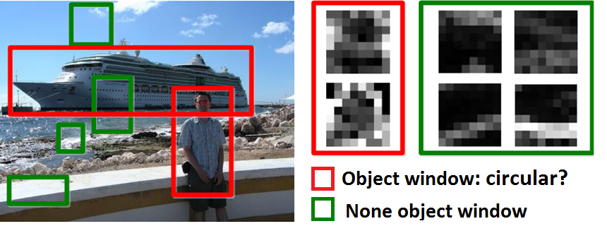
Methodology: observation
Objects are stand-alone things with well defined closed boundaries and centers.
Little variations could present in such abstracted view.
Finding pictures of objects in large collections of images. Springer Berlin Heidelberg, 1996, Forsyth et. al.
Using stuff to find things. ECCV 2008, Heitz et. al.
Measuring the objectness of image window, IEEE TPAMI 2012, Alexe et. al.

Slide 29
Methodology
Normed gradients (NG) + Cascaded linear SVMs
Normed gradient means Euclidean norm of the gradient

Slide 30
Methodology
Normed gradients (NG) + Cascaded linear SVMs
Detect at different scale and aspect ratio
An 8x8 region in the normed gradient maps forms a 64D feature for an window in source image
Simultaneous Object Detection and Ranking with Weak Supervision, NIPS 2010, Blaschko et. al.
Proposal Generation for Object Detection using Cascaded Ranking SVMs. CVPR 2011, Zhang et. al.
LibLinear: A library for large linear classiﬁcation, JMLR 2008, Fan et. al.
Learning a Category Independent Object Detection Cascade. ICCV 2011, Rahtu et. al.

Slide 31
Methodology
Model weights can be binary approximated
Binarized feature could be tested using fast BITWISE AND and BIT COUNT operations
Efficient online structured output learning for keypoint-based object tracking. CVPR 2012, Hare et. al.
Binarized normed gradients (BING)
Binary approximate of the NG feature (a BYTE value)
Using top $N_{g}$ binary bits of a BYTE value.
E.g. Decimal: 210 →Binary: 11010010→Top $N_{g}=4$ bits: 1101
$210≈\sum_{k=1}^{N_{w}}{2^{8−k}b_{k,l}}=1∗2^{8−1}+1∗2^{8−2}+0∗2^{8−3}+1∗2^{8−4}$

Slide 32
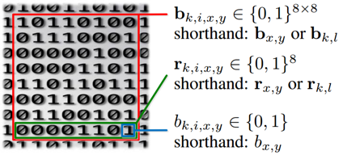
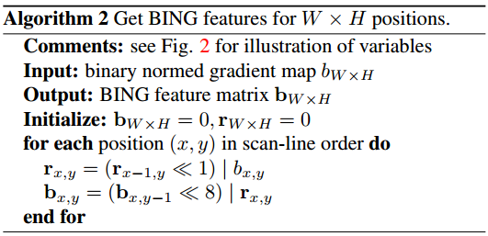
Methodology
Getting BING feature: illustration of the representations
Getting BING feature

Slide 33
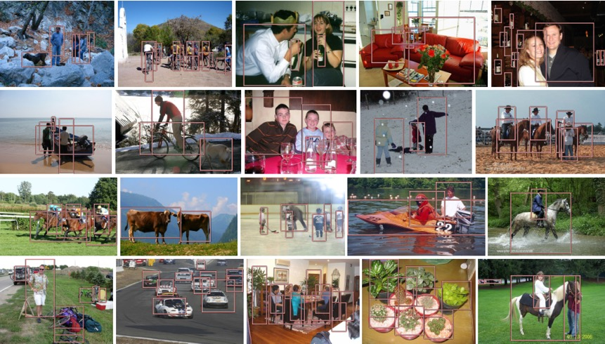
Experimental results
Sample true positives on PASCAL VOC 2007

Slide 34
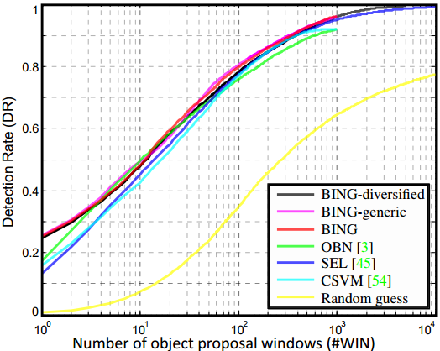
Experimental results
Proposal quality on PASCAL VOC 2007

Slide 35
Experimental results
Computational time
A laptop with an Intel i7-3940XM CPU
20 seconds for training on the PASCAL 2007 training set!!
Testing time 300fps on VOC 2007 images
Method | [1] | OBN [2] | CSVM [3] | SEL [4] | Our BING
Time (seconds) | 89.2 | 3.14 | 1.32 | 11.2 | 0.003
Category-Independent Object Proposals With Diverse Ranking, PAMI 2014, Endres et. al.
Measuring the objectness of image windows. PAMI 2012, Alexe, et. al.
Proposal Generation for Object Detection using Cascaded Ranking SVMs. CVPR 2011, Zhang et. al.
Selective Search for Object Recognition, IJCV 2013, Uijlings et. al.

Slide 36
Conclusion and Future Work
Conclusions
Surprisingly simple, fast, and high quality objectness measure
Needs a few atomic operation (i.e. add, bitwise, etc.) per window
Test time: 300fps!
Training time on the entire VOC07 dataset takes 20 seconds!
State of the art results on challenging VOC benchmark
96.2% Detection rate (DR) @ 1K proposals, 99.5% DR @ 5K proposals
Generic over classes, training on 6 classes and test on other classes
100+ lines of C++ to implement the algorithm
Resources: http://mmcheng.net/bing/
Source code, data, slides, links, online FAQs, etc.
1000+ source code downloads in 1 week
Already got many feedbacks reporting detection speed up
free

Slide 37
ImageSpirit: Verbal Guided Image Parsing, ACM TOG, 2014, M.M. Cheng et. al.

Slide 38
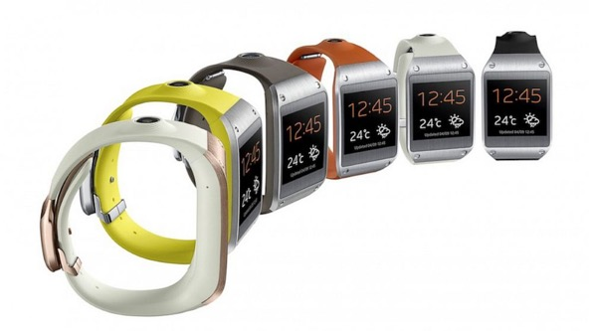
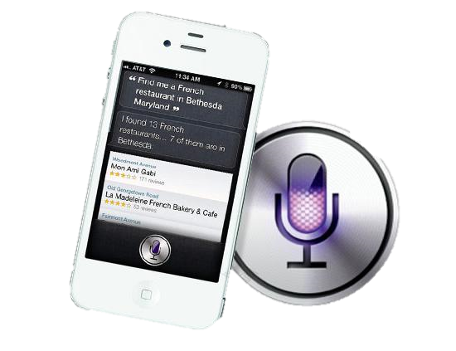
Motivations

Slide 39
Verbal guided image parsing
Make the wood cabinet in bottom-middle lower
nouns
Adjective
Verb/Adverb
Object Attributes
Commands
Multi label CRF

Slide 40
Multi-Label Factorial CRF
$$E\left(z\right)=\overset{Unary}{\overbrace{\sum_{i∈I}{ψ_{i}\left(z_{i}\right)}}}+\overset{Pairwise}{\overbrace{\sum_{i≠j∈I}{ψ_{ij}(z_{i},z_{j})}}}$$
$$ψ_{i}\left(z_{i}\right)=\overset{Object}{\overbrace{ψ_{i}^{O}\left(x_{i}\right)}}+\overset{Attributes}{\overbrace{\sum_{a}{ψ_{i,a}^{A}(y_{i,a})}}}+\overset{Joint Object−Attribute}{\overbrace{\sum_{o,a}{ψ_{i,o,a}^{OA}}\left(x_{i},y_{i,a}\right)}}+\overset{Joint Attribute−Attribute}{\overbrace{\sum_{a≠a^{′}}{ψ_{i,a,a^{′}}^{A}(y_{i,a},y_{i,a^{′}})}}}$$
Object classifiers: table, chair, etc.
Object and attributes correlation.
Correlation between attributes.
Attributes classifiers: wood, plastic, red, etc.

Slide 41
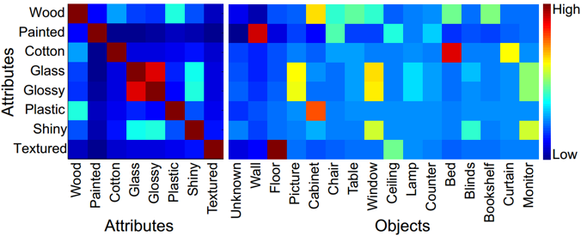
Joint inference

Slide 42
Verbal guided image parsing
Source code
http://mmcheng.net/imagespirit/
Demo video
free

Slide 43
SemanticPaint

Slide 44
Motivation

Slide 45
SemanticPaint
SemanticPaint: Interactive 3D Labeling and Learning at your Fingertips, ACM TOG 2015.

Slide 46
SemanticPaint: Demo

Slide 47
SemanticPaint
Highlight
Personalized
Recognition in 3D
Learning in the environment
User in the loop
Source code
http://mmcheng.net/s-paint/
free

Slide 48
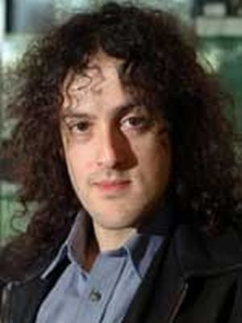
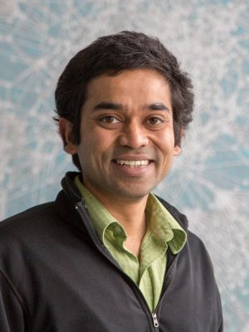
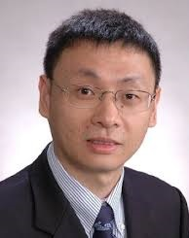
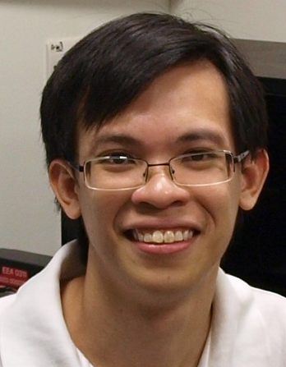
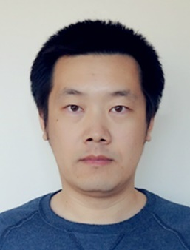
Collaborators (partial list)

Slide 49
free

Slide 50
Thanks
Q&A

Slide 51
VALSE & VALSE Webinar
VALSE: Vision And Learning SEminar
VALSE Annual Conference
No submission, no registration fee, end of April
Expected 1000 attendees this year.
Invited talks & poster of published CVPR, ICCV, PAMI papers
Tutorial, Panel …
VALSE QQ group (about 6000+ faculties and research students)
Interested? Group NO. 480822477
VALSE weakly Webinar (online)
Wednesday,
Any where there is internet
Attendees NO.: 600+
More information: http://valser.org

Slide 52
VALSE主要组织者和参与者
VALSE主要组织者
联合发起人
山世光, 潘纲, 刘青山, 颜水成, 李学龙
指导委员会（拼音序）
白翔, 高新波, 何晓飞, 黄华, 李学龙, 刘青山, 马毅, 潘纲, 山世光, 徐东, 颜水成, 杨健, 余凯, 周昆, 周志华
VALSE Online主要组织者
主要发起人
山世光, 白翔, 程明明, 孟德宇, 彭玺, 禹之鼎, 贾伟
首届VALSE Online理事会（拼音序）
白翔, 程明明, 邓成, 董乐, 董伟生, 纪荣嵘, 贾伟, 林倞, 鲁继文, 孟德宇, 彭玺, 山世光, 王乃岩, 王瑞平, 禹之鼎, 章国锋, 张利军, 张兆翔, 郑海永, 郑伟诗, 左旺孟

